Slide 1

Real Autobots and Decepticons
Programming a Self-Reconfiguring Robot
Notes:
Introduce ourselves 30 seconds

Slide 2



Notes:
Hook: Talk about self-reconfiguring robots 30-45 seconds

Slide 3

Research Question
Is it possible to achieve unaided organization of modules into a predetermined formation from completely random starting points?
Notes:
Explain our research question 60 seconds

Slide 4
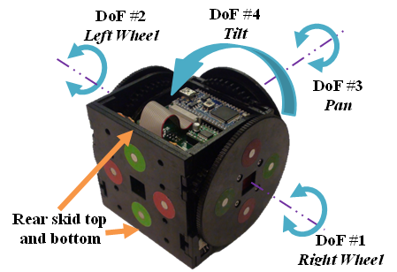
Notes:
Describe what the ECE department has been doing 1 minute

Slide 5
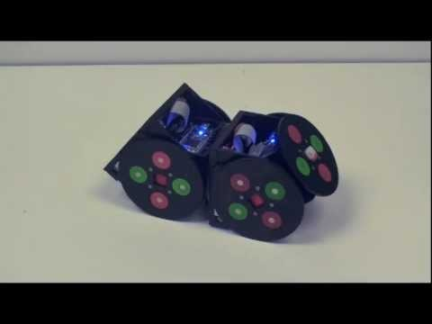
a
Notes:
Show video about how they work 90 seconds
Is there a better video?

Slide 6
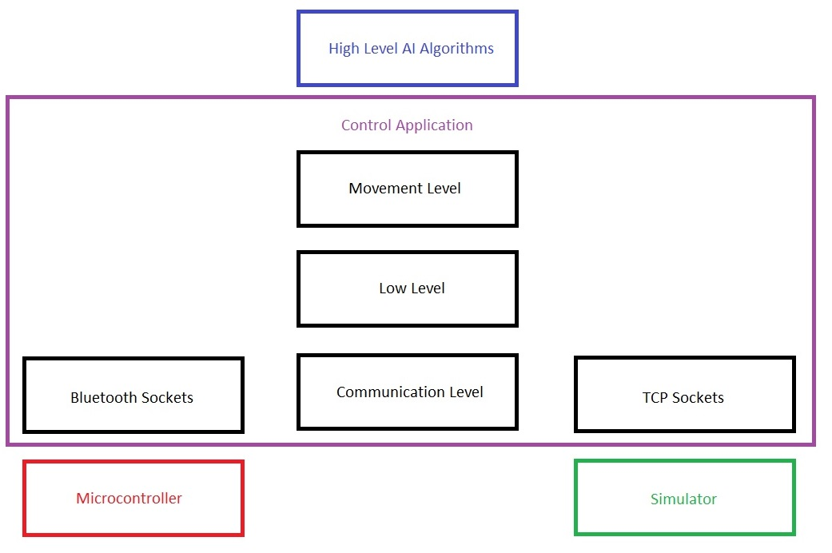
Requirements
Basic Control of Physical Robots
Virtual Models in Webots Simulator
Python Control Application
Python Algorithms for 2-3 Formations
Notes:
Discuss the 3 main requirements and why we need them. 1 min each

Slide 7

Risks
Roadblocks
Python Bluetooth support
Unfinished Bots
Simulator Network API
Alternate Solution
Create adaptor in alternate language
4-6 formations in simulator only
Find a new simulator
Notes:
Explain the three major unknowns 1 min each
1. If python’s BLE support is insufficient then we will have to make an adaptor in an alternate laguage
2. If the ECE guys don’t give us a working bot then we will try to do more formations in the simulator only
3. If the simulator doesn’t work with a known api (HTTP, Bluetooth, etc) we will need to find a new simulator. This might screw us over.

Slide 8

Q & A
Notes:
Answer Questions

